Slide 1
Guardians of the Sounds
Annual General Meeting , 07th September 2020
Tell me if you like to Modern Chairman's Report
It will be posted on the GOS Website for Download
Emailed out to members of GOS

Slide 2
Welcome , Kia Ora to all
Hope you all had a good year enjoying the beautiful Marlborough Sounds. With COVID now in our lives , appreciating what we have here and protecting it is even more important . Thanks to all members for your Support.
Our Mission as Guardians of the Sounds is to
“Save the Sounds for Future Generations ……….

Slide 3
Special thanks for Support
Peter Beech : Our Patron
Bill Foster : Deputy Chairman
Clare Pinder : Treasurer ( special thanks )
Martin Pinder : Committee Member (facebook)
Carolyn Edwards : Secretary
Committee Members : New and Old Committee members

Slide 4
Conservation and Youth in Marlborough
Marlborough Girls College have started discussion with us regarding how they can be more involved with GOS . 900 Students .
Queen Charlotte College are helping with TREE planting
GOS wants to engage with Youth in Marlborough
Group / School subscription Membership .$45 per year
Youth Guardians Material and Hectors Dolphin Teaching sent out
We would like to have Youth on GOS Committee
Working together To Save the Sounds for Future Generations

Slide 5
Team Work with Community
Collaboration and working together is the way forward, for us and the community.
In 2020 we have worked alongside Marlborough District Council , Port Marlborough , Te Atiawa , Picton Clean Air Group ,Picton Harbour Master , Kiwi Rail on the issues of clean air.
IREX team from Kiwi Rail and the NEW Ferry development are engaged with us Peter Beech and I are presenting a RISK Based document to IREX team this month.
Marlborough Environmental Plan involvement has been through Bill Foster being involved with Marlborough Marine Futures, MMF. Bill and Clare Pinder have also been involved in the Submission process for the MEP and NZMS.
This will be ongoing as COVID has slowed the whole process.

Slide 6
Areas GOS involved in for 2020
Picton Clean Air Group – monitoring completed and stations removed 4th September 2020. Now NIWA to write a report over next few months.
New Zealand King Salmon application for a large Farm to be placed in the Outer Marlborough Sounds . A Bottom Survey was conducted and sponsored to Friends of Nelson Haven.
Bill Foster was liaison with Sea Shepard to provide information about the large Farm application
Bill Foster and Clare Pinder both working on Marine Matters and MEP
Peter Beech and Paul working with KiwiRail
Mike working on Membership

Slide 7
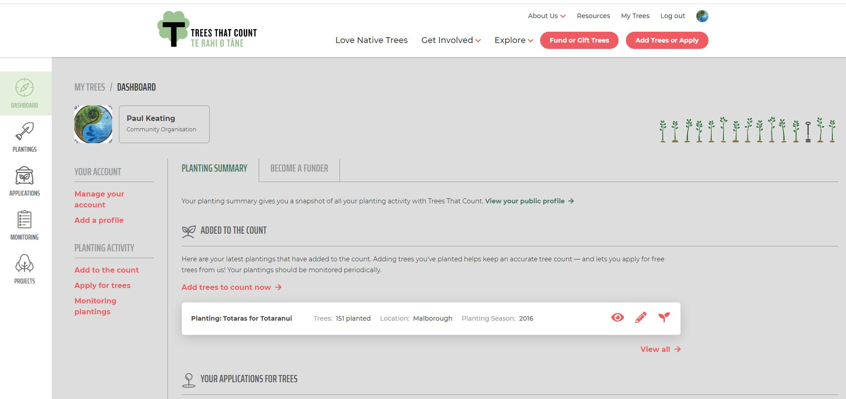
Totaras for Totaranui

Slide 8
Totaras for Totaranui- 745 Trees
We have now 3 properties in the outer Sounds to plant trees on .
The Planting areas are , Resolution Bay – Podmores Proerty -2020
Te Ipapakereru Bay ( Hectors Berthign Bay ) – 2020/ 2021
Marlborough Sounds Restoration Trust – Wharehunga bay -2021
Jobs for Nature funding for 4 full time employees, DOC , MDC.
Marine Protected Area – local IWI / Landowners / Council
Hectors Dolphins affected by sedimentation Science being conducted by Danny Spencer , Miranda Van De Linde .
Marine Mammals Data Base from 1992 to 2020- 4500+ Sightings.

Slide 9
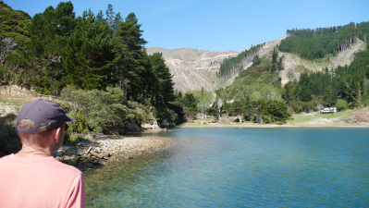
Totaras for Totaranui Project https://www.totarasfortotaranui.org.nz/

Slide 10
HELP Needed for 2020 in Project
Help to plant in Picton behind Rescue Centre during October ( 4 hours )
Help to plant out in Outer Sounds / Resolution Bay and Te Ipapa ( 1-2 Days)
Media campaign to promote a Marine Protected area .
Local community ( Sounds ) liaison to discuses proposal.
Social Media capable person for Public Support

Slide 11
New Zealand King Salmon – Clare Pinder
The Guardians, Friends of Nelson Haven, Keneperu Central Sounds Residents Association (KCSRA) and Marlborough Environment Centre (MEC) have continued to work collaboratively together on resource consents and changes to resource consent conditions by NZ King Salmon.
Waitata Reach consent to increase area by four pens. Rejected by Commissioner Mills as Waitata Reach is not meeting existing consent conditions on the depositional footprint. Further submissions made by NZKS to increase feed levels and alter consent condition on Best Practice Guidelines (BMP Guidelines) will be opposed (deadline 23rd September 2020)
Ngamahau , Kopaua and Clay point Consents will al be opossedas they are Non Compliant consent to increase feed levels will be opposed as they are technically non-compliant.
Guardians and KCRSA submitted on Forestry supporting more stringent regulations on setbacks, runoff, and other environmental issues. The response from Council was weak but there were some minor wins. Friends submitted on Outstanding Character and the Guardians and KCSRA are supporting Friends via section 274 A of the Resource Management Act. Friends are funding this. MEC Submitting on NZKS ecologically significant marine sites. Opposing Marine Farmers and other aquaculture appellants. MEC Submitting on NZKS ecologically significant marine sites. Opposing Marine Farmers and other aquaculture appellants.

Slide 12
New Zealand King Salmon
Cape Lambert.
Cape Lambert Submission to farm 172 hectares in Cook Strait (Outer Sounds). Underwater evidence has been gathered using and ROV (underwater video). GOS enabled this to be done after numerous frustrations with suppliers. A scientific expert has been hired to interpret the data, analyse reporting and evidence from Cawthron Institute (NZKS), and present evidence at the hearing on behalf of Friends of Nelson Haven. Friends are leading the response with lawyer Julian Ironside who is an expert on the RMA. Friends are supported by the Guardians , KCSRA and Marlborough Environment Centre.
The hearing will be run by the Council which means that none of the groups are eligible for Government funding. When a case is heard in the Environment Court there is the ability to apply for up to $40,000 for lawyers and expert witnesses. So far $20,000 has been raised against the cost of $25,000 of raising the appeal. If anyone is able to assist with a donation it would be greatly appreciated. $5000 is Needed – GOS to give $500

Slide 13
Forestry in the Sounds . MEP.
Guardians and KCRSA submitted on Forestry supporting more stringent regulations on setbacks, runoff, and other environmental issues. The response from Council was weak but there were some minor wins.
Friends submitted on Outstanding Character and the Guardians and KCSRA are supporting Friends via section 274 A of the Resource Management Act. Friends are funding this. MEC Submitting on NZKS ecologically significant marine sites.
Opposing Marine Farmers and other aquaculture appellants. MEC Submitting on NZKS ecologically significant marine sites.
Bill Foster has pointed out that NO one is happy with MEP and council are now tied up in litigation over it.

Slide 14
Other Issues
Any other issues to discuss ?
Questions to the Chair ?
New Committee Members ?

Slide 15
How can you help !
Help with News updates – Send to paul@e-ko.nz for posting
Help with Website operations / Database (emailing list)
Help with Projects- see Paul
Tell everyone in the Community to join GOS
Help plant Trees October 2020.
Pay up Subs , $25.00 Single $35 Family GOS Website
Thanks for your Support ☺

Slide 16

Remember our Mission!
“To Save the Sounds for Future Generations”

